Slide 1


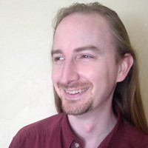


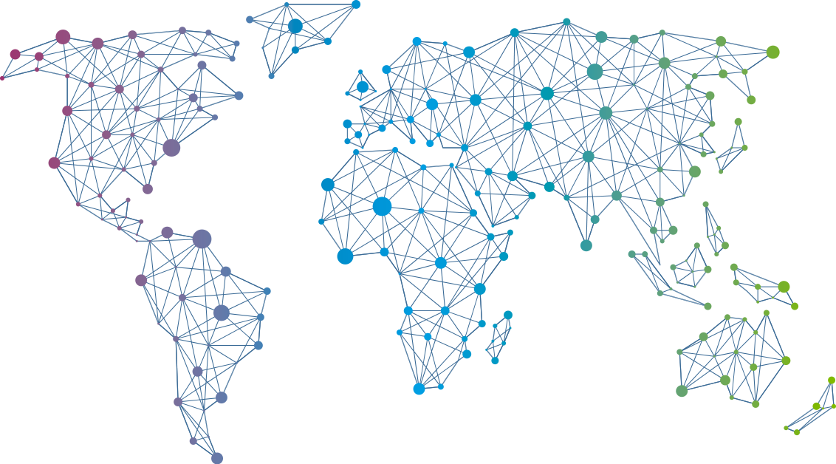

Speaker
Rob Richardson
Level-up Your DevOps with GitHub Actions and Kubernetes
Transition from a Build Script to a Dockerfile
Rob Richardson
rob_rich
September 16th & 17th
^{Online Event}
Powered By
International Conference

